Slide 1







EV BATTERY THERMAL & COOLING OPTIMIZATION
Physics + ML Hybrid Cooling Simulation
AI
Team Lead Name
MOULESH S
Team Members
RAGURAMAN J
ANANTH KUMAR A
AI
AI
AI
AI
AI
AI
AI
AI
AI
Mentor : SANTHOSH P
College Name – University College of Engineering Villupuram
AI

Slide 2
Project Objectives
Problem Statement
Project Overview – Introduction
End Users
01
02
03
Wow Factors in Project
Modelling / Block Diagram / Flow of Project
Technology Stack
04
05
06
Result / Outcomes
Conclusion
Future Perspective
07
08
09

Slide 3
Problem Statement
1. Overheating Under Load
Highway and hill-climb bursts push cell current past 10 A.
With no cooling, the core peaks at 44.2°C.
The core stays above 35°C for 58.4% of the run.
2. Reactive Cooling Lags
Bang-bang cooling waits until the surface reaches 34°C.
Core still peaks at 36.8°C and is over 35°C for 14.2% of the run.
On/off switching gives a high wear score of 14.2.
3. Cooling Costs Energy
Pump power grows with flow cubed (P ∝ u³).
Hard, late cooling is wasteful: 1.75 Wh for bang-bang.
Cooling must start early and stay just strong enough.
Project Goal: Build an interactive physics + ML simulator that compares four cooling strategies on a 21700 battery cell and finds the one that protects it with the least pump energy.

Slide 4
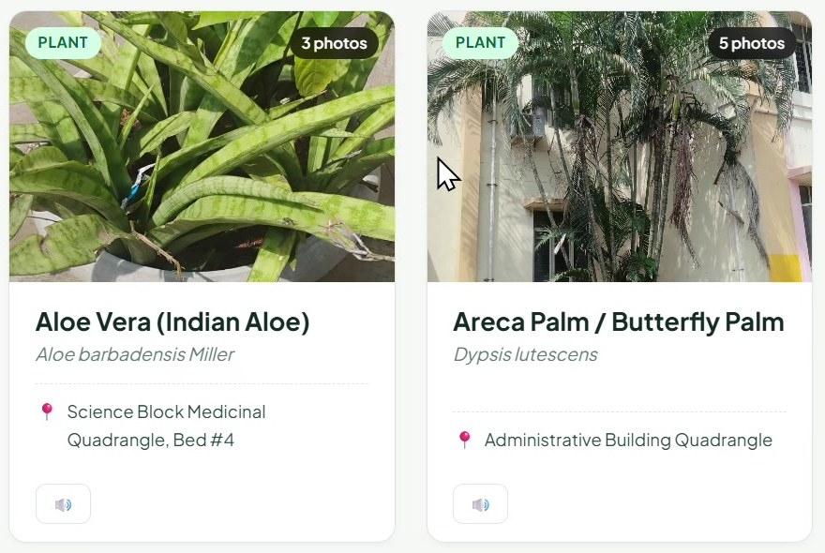
Project Overview - Introduction
The EV Battery Thermal & Cooling Simulation is a browser dashboard that models a 21700 cell with a two-state thermal model and compares four cooling strategies live, including an ML look-ahead controller.
21700
cell format modelled
2
thermal states: core and surface
Two-state (core / surface) lumped thermal model.
Bernardi heat generation with temperature and aging effects.
4
cooling strategies compared
4
drive-load profiles
Four strategies: Passive, Bang-Bang, PID and ML Look-Ahead.
Live waveforms, metrics and a 21700 cell thermal view.
Four load profiles, including NASA B0005 and fast charge.
Live benchmark table comparing all four strategies.
Model at a glance

Slide 5







End Users
EV Thermal / BMS Engineers
Battery Researchers
Students & Educators
Pack & Cooling Designers
Compare cooling controllers before building any hardware.
Study heat generation, aging and the core-to-surface gradient.
Teach thermal management and control with a live demo.
Judge pump energy against protection when sizing cooling.
One platform to model • predict • cool • save energy

Slide 6











Wow Factors in Project
ML Look-Ahead Cooling
Live Strategy Switching
Real-Time Waveforms
Forecasts core temperature 10 s ahead and pre-cools before the heat spike.
Switch between four controllers while the simulation keeps running.
90-second strip charts of temperature, coolant flow and load current.
21700 Cell Thermal View
Live Benchmark Table
What-If Controls
Core, surface and coolant ring change colour as the cell heats up.
Peak temperature, time over 35°C, pump energy and wear score.
15 A burst pulse, ambient and coolant sliders, aging cycles, 1x-10x speed.

Slide 7



Modelling/Block Diagram/Flow of Project
INPUT
Simulation & Control Engine (1 s step)
OUTPUT
Heat Generation
Bernardi: I²R + entropic heat; Arrhenius R_int and aging
Thermal Model
Core / surface equations, C = 38 / 8 J/K
Live Waveforms
Temperature, flow, current
Drive Profile
Load current I(t): city/highway, NASA B0005, fast charge, hill climb
Cell Thermal View
21700 core and surface
ML Forecast
Predicts core temperature 10 s ahead
Cooling Controller
Passive, Bang-Bang, PID or Look-Ahead sets flow u
Metrics Strip
Six live readouts
Environment & Aging
Ambient and coolant temperature sliders, battery cycle index
Benchmark Table
All four strategies
Delivery: single responsive web dashboard (HTML, Tailwind CSS, Canvas and SVG) that runs in any browser

Slide 8






Technology Stack
Physics Model
Control & ML
Frontend
Lumped 2-state thermal equations
Bernardi heat generation
Arrhenius R_int + aging factor
Euler step, dt = 1 s
Bang-Bang: on 34°C, off 29.5°C
PID with a 30°C target
ML look-ahead forecast, t + 10 s
Slew-limited flow command
HTML5 and JavaScript
Tailwind CSS responsive layout
Selectors, sliders, burst button
Dark dashboard theme
Visualization
Actuator & Energy
HTML5 Canvas strip charts (90 s window)
Inline SVG 21700 cell cross-section
Live status badges and metric tiles
Pump power P = 45 W × u³
Maximum cooling transfer 2.5 W/K
Cumulative parasitic energy in Wh

Slide 9

LIVE DASHBOARD & METRICS
Result/Outcomes
BASELINE
Passive (No Cooling)
u = 0, natural convection
REACTIVE
Hysteresis (Bang-Bang)
On at 34°C, off at 29.5°C
FEEDBACK
Closed-Loop PID
P-I-D feedback control
OPTIMAL AI
ML Look-Ahead (MPC)
Anticipatory pre-cooling
Core Temp
24.0 °C
Normal operating
Surface Temp
24.0 °C
From thermistor
Forecast +10 s
24.0 °C
Steady trend
Load Current
0.0 A
0.0 W heat gen.
Coolant Flow
0.0 %
0.0 W parasitic
Parasitic Energy
0.000 Wh
Saving vs ref.
Metric values shown are the simulation start state (24°C ambient, 0 A load).
Header controls: Run / Pause, 15 A Burst Pulse, Reset and 1x to 10x simulation speed.
Panels: live waveforms, 21700 cell view, drive-cycle parameters and the strategy benchmark.

Slide 10
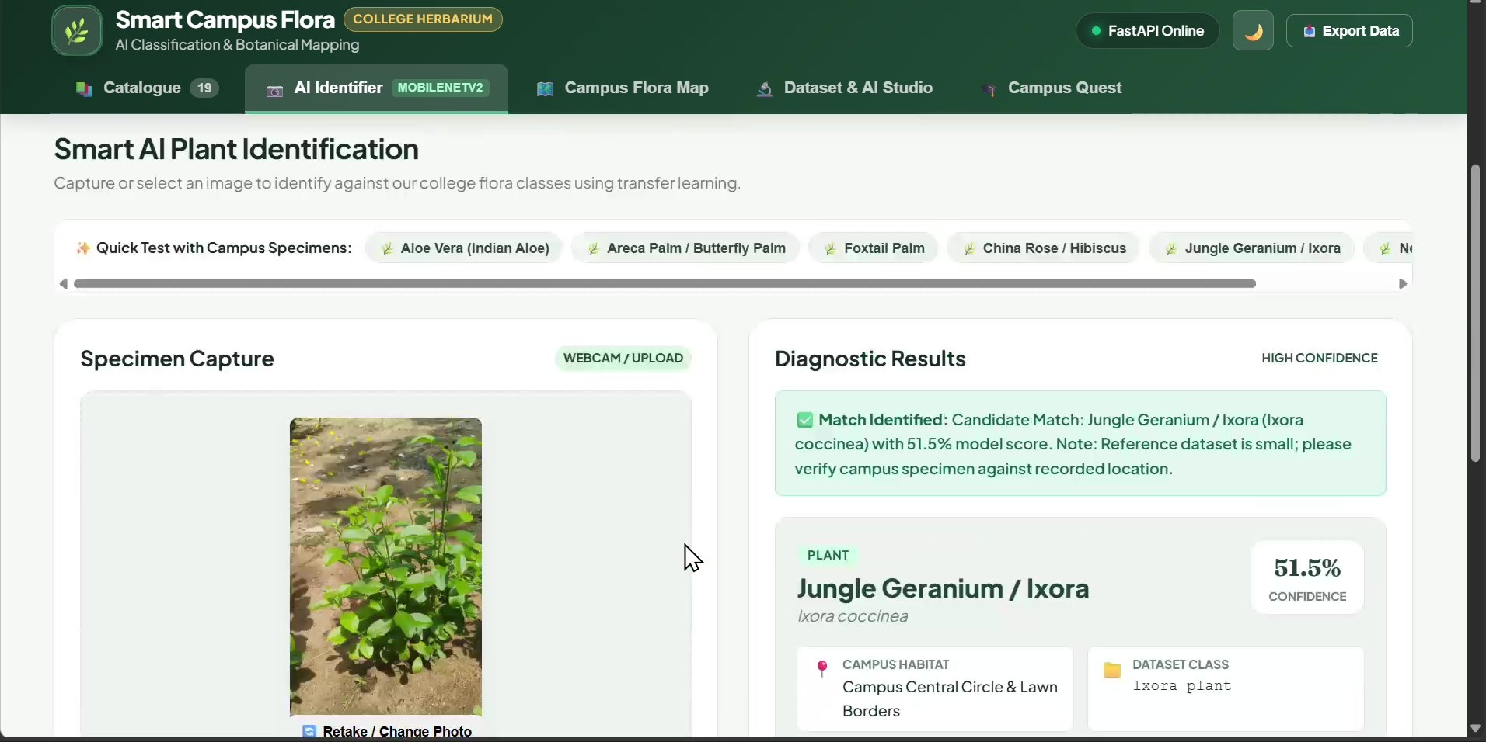
LOAD PROFILE & LIVE WAVEFORMS
Result/Outcomes
Waveform panel guide
T_core
T_surf
Forecast (t+10 s)
Target 30°C
Critical limit 35°C
Coolant flow u(t)
Load current I(t)
75 s cycle: idle, urban cruise, highway burst (up to 13 A), regenerative braking (-2.5 A), moderate cruise, coast. The burst is what drives the heat spike.

Slide 11
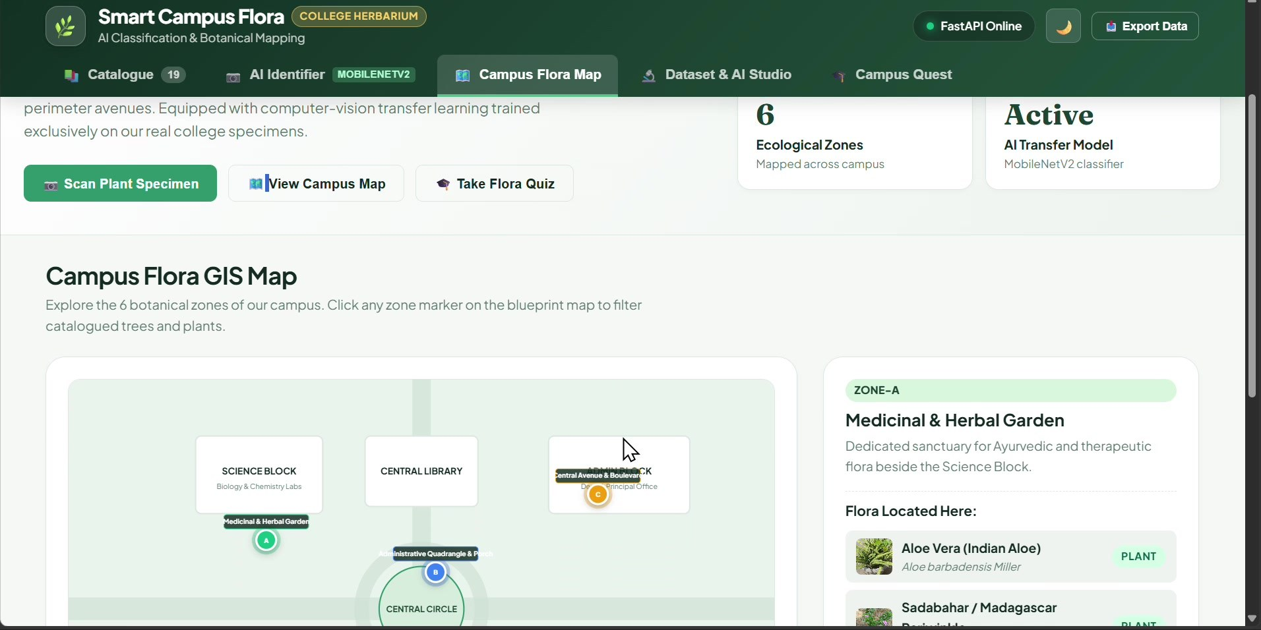
21700 CELL THERMAL STATE & DIAGNOSTICS
Result/Outcomes
Core status badges
Optimal Zone
core ≤ 30.5°C
Cooling Engaged
30.5 to 35°C
Thermal Stress
core > 35°C
Cell colour scale (°C)
< 26
26-30
30-33
33-36
≥ 36
CORE
T_core
ΔT (core - surface)
0.00°C
Internal resistance R_int
45.0 mΩ
SURFACE T_surf
Cooling power Q_cool
0.0 W
Estimated SOC
95.0%
Coolant jacket (cold plate)
Diagnostic values shown are the start state.

Slide 12
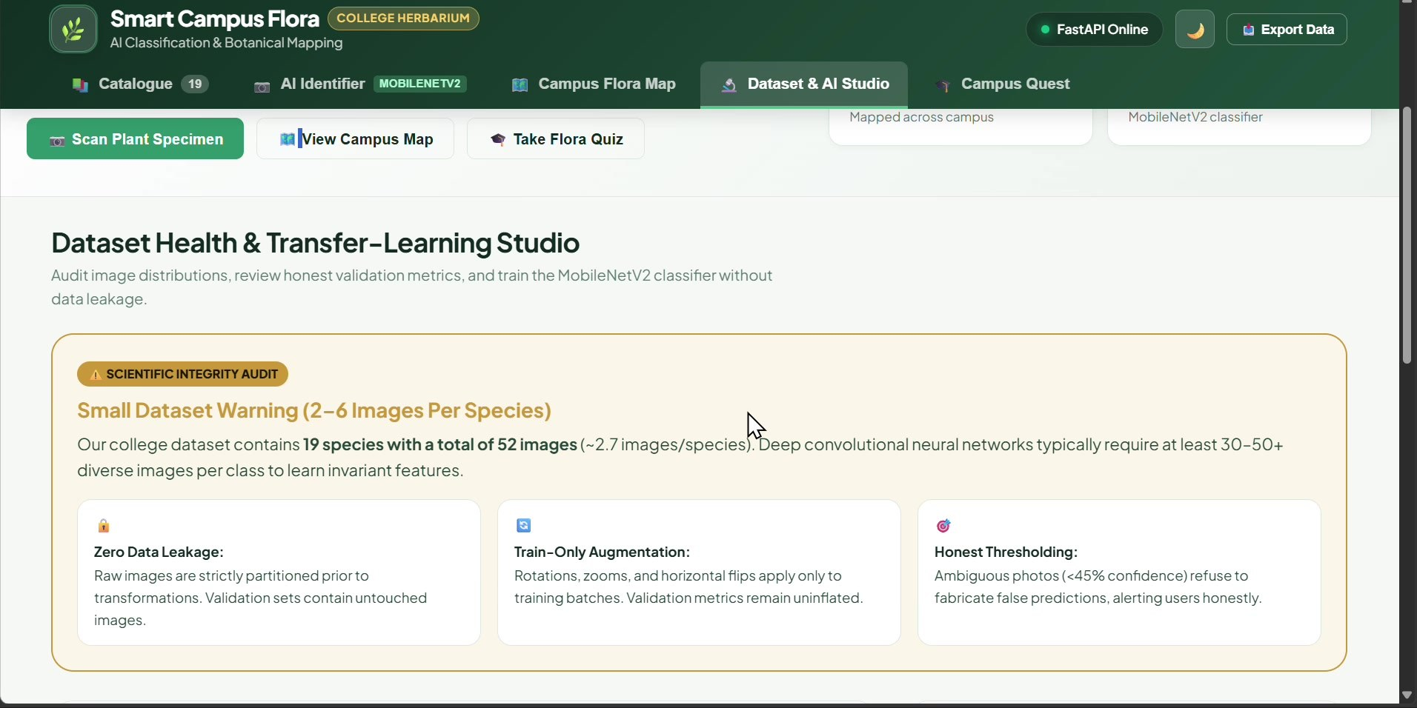
STRATEGY BENCHMARK
Result/Outcomes
Strategy | Max core | > 35°C | Energy | Saving | Wear score
Uncontrolled (Passive) | 44.2°C | 58.4% | 0.00 Wh | -- | 0.0
Hysteresis (Bang-Bang) | 36.8°C | 14.2% | 1.75 Wh | Reference | 14.2 High
Closed-Loop PID | 33.9°C | 0.0% | 0.92 Wh | +47.4% | 6.8 Med
ML Look-Ahead (MPC) | 31.8°C | 0.0% | 0.41 Wh | +76.5% | 3.2 Smooth
Values as shown in the dashboard benchmark table.
Optimization insight: pre-cooling at a moderate flow rate uses the pump affinity law, P ∝ u³. It removes the heat spikes and cuts parasitic energy by over 75% compared with bang-bang cooling.

Slide 13

PUMP AFFINITY LAW & ENERGY SAVINGS
Result/Outcomes
Takeaway: half flow needs only 12.5% of full pump power, so gentle early cooling beats late full-flow bursts.

Slide 14
Conclusion
EV BATTERY THERMAL & COOLING OPTIMIZATION
Models a 21700 cell with a two-state thermal model and Bernardi heat generation.
Compares Passive, Bang-Bang, PID and ML Look-Ahead cooling on identical loads.
ML look-ahead holds the core at 31.8°C with no time above 35°C.
Pre-cooling cuts parasitic pump energy by 76.5% versus bang-bang.
Gives engineers and students a real-time, interactive thermal tool.
Future Goal: validate against real cell data and replace the rule-based look-ahead with a trained forecaster.

Slide 15











Future perspective
Real Cell Validation – Fit the model to measured NASA B0005 and thermistor data.
Trained Forecaster – Replace the rule-based look-ahead with a learned model.
Pack-Level Model – Extend from one cell to a multi-cell pack and cold plate.
Hardware-in-the-Loop – Drive a real pump and BMS with the controller.
Aging-Aware Control – Adapt cooling as internal resistance grows with cycles.
Fast-Charge Limits – Tie charge-rate limits to cell temperature.
Real Data
ML Forecaster
Pack Model
HIL Testing
Aging-Aware
Fast Charge
Future Goal: a validated, pack-level thermal platform with a learned controller ready for real hardware.

Slide 16
Thank You !!

